Slide 1

Authenticated Key Agreement Scheme for Fog Computing in a Health-Care Environment
Course: CSE 707
Sania Azhmee Bhuiyan
ID: 23266033
Team: 16
Course instructor: Annajiat Alim Rasel

Slide 2
Some definitions and common terms used in the paper
Fog computing is a distributed computing system used in the Internet of Things (IoT).
IoT devices are physical objects or appliances embedded with sensors, software, and connectivity to collect and exchange data over the internet eg laptop, mobile phones
Cloud computing refers to the delivery of various computing services, including storage, processing, and software, over the internet, offering on-demand access and scalability.

Slide 3
Motivation: The paper addresses the limitations of cloud computing, especially in healthcare scenarios where the centralization of data in the cloud raises concerns about data retrieval times, energy consumption, and response delays.
Contribution: The paper proposes an elliptic curve cryptography-based mutual authentication key establishment scheme for fog computing in Healthcare system addressing security challenges in identity authentication. It introduces a novel architecture allowing fog nodes to assume verification tasks, reducing the computational load on the cloud server.
The paper presents a mutual authentication key establishment scheme based on elliptic curve cryptography to address these security concerns in fog computing.

Slide 4
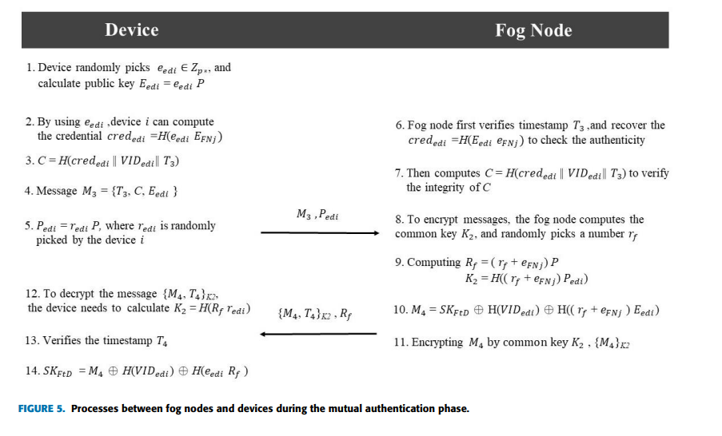
Methodology
Verifying and securing IoT devices and fog nodes in a fog-based healthcare environment.
Involveed device and fog node registration, mutual authentication, and key establishment
1. Device and Fog Node Registration
2. Mutual Authentication and Key Establishment
3. Intra-Fog Authentication

Slide 5
Security maintenance at different stage/problem/attacks
ANONYMITY AND UN-TRACEABILITY To prevent an adversary from obtaining the identities of other devices when the message is transmitting, hash values and ciphertext are combined; therefore, the devices’ identities are hidden in the ciphertexts.
REPLAY ATTACK While transmitting messages, each message contains a timestamp; therefore, only the message within the legal time interval will be admitted
MAN-IN-THE-MIDDLE-ATTACK involves an attacker intercepting and altering communications between a device and a fog node by exploiting the challenge of solving the elliptic curve discrete logarithm problem to obtain the device's ephemeral private key

Slide 6
Conclusion
Overall, It addresses challenges related to data privacy and system compatibility in delivering medical records. The method involves fog nodes in authenticating devices, reducing the computational burden on the cloud server. Through a detailed analysis using the random oracle model and the extended Canetti-Krawczyk threat model, the protocol is proven secure against various attacks. In comparison with other methods, it is concluded that the proposed protocol is both secure and efficient, contributing to improved medical services.

Slide 7
Limitation
The fog computing architecture lacks a thorough scalability analysis, limiting its practical use, especially in healthcare scenarios with numerous connected devices.
Despite addressing security measures, the paper neglects potential vulnerabilities arising from hardware or software failures. It lacks a comprehensive examination of the system's resilience in real-world scenarios, where such failures are common.

Slide 8
THANK YOU

